Slide 1
Unit 1

Slide 2
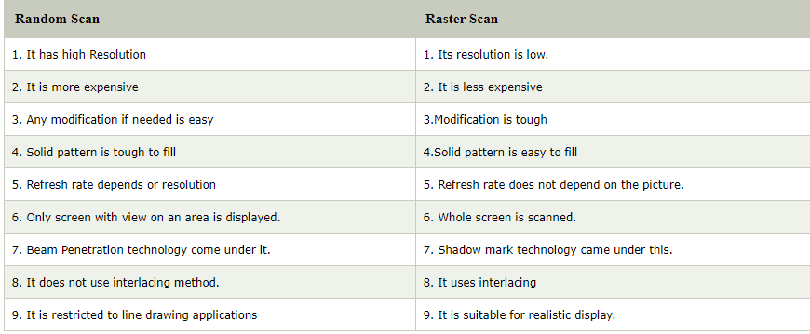
Differences between raster scan display and random scan display

Slide 3
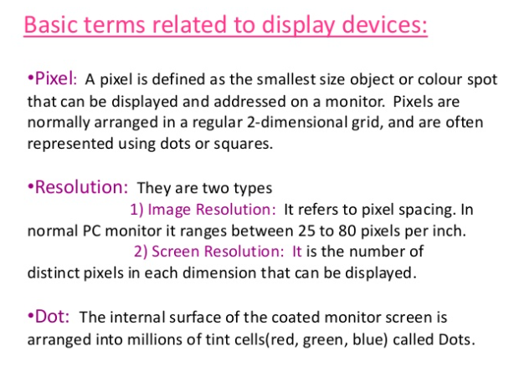

Slide 4
Concept of Pixel
Pixel
The full form of the pixel is "Picture Element." It is also known as "PEL." Pixel is the smallest element of an image on a computer display, whether they are LCD or CRT monitors. A screen is made up of a matrix of thousands or millions of pixels. A pixel is represented with a dot or a square on a computer screen.
.

Slide 5
The good thing is that a pixel cannot be seen as they are very small which result in a smooth and clear image rather than "pixelated." Each pixel has a value, or we can say a unique logical address.
It can have only one color at a time.
Colour of a pixel is determined by the number of bits which is used to represent it.
A resolution of a computer screen depends upon graphics card and display monitor, the quantity, size and color combination of pixels

Slide 6
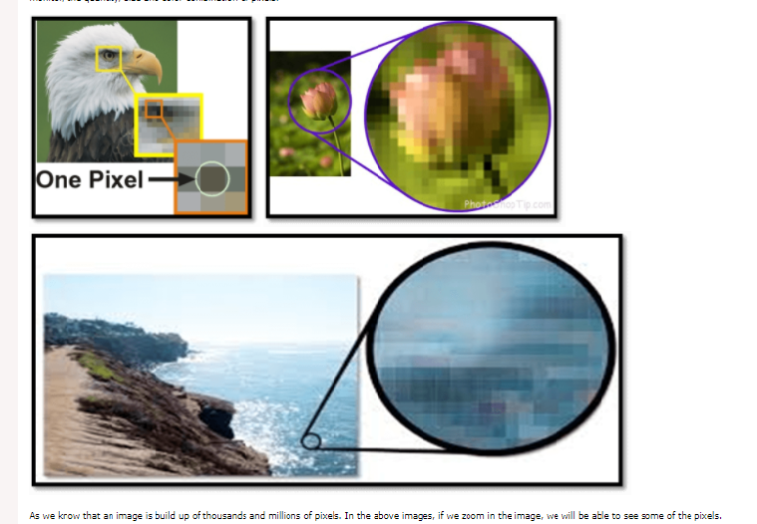

Slide 7


If such an electronic image is enlarged a lot, you can see that it consists of a matrix of picture elements. Such picture elements are called pixels. Below are the pixels that make up the eye of the bird.

Slide 8
Resolution as the definition of the number of pixels
In the above image, each row contains 3000 pixels and there are 2000 rows. Resolution describes the image size as the number of pixels it contains, typically as ‘width x height‘.
That means the above image of the bird has a resolution of 3000 x 2000 pixels.
Sometimes users are only interested in the total number of pixels. Those 6 million pixels equal a resolution of 6 megapixels.
The habit of using the term resolution to refer to the number of pixels in an image is typical for the photography market.

Slide 9
What is screen resolution?
The number of horizontal and vertical pixels on a display screen.
The more pixels, the more information is visible without scrolling.
Screen resolutions have a pixel count such as 1600x1200, which means 1,600 horizontal pixels and 1,200 vertical pixels.

Slide 10
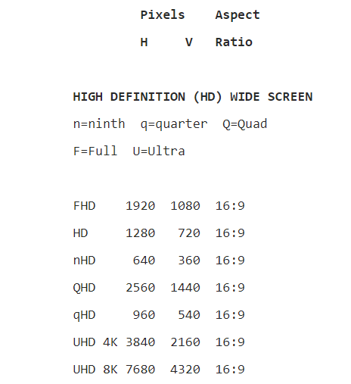
Examples of screen resolution

Slide 11
Frame buffer organization and types of Frame buffers

Slide 12
What is frame buffer??
A framebuffer ( frame store) is a portion of random-access memory (RAM) containing a bitmap that drives a video display.
It is a memory buffer containing data representing all the pixels in a complete video frame.
Modern video cards contain framebuffer circuitry in their cores.
This circuitry converts an in-memory bitmap into a video signal that can be displayed on a computer monitor.

Slide 13
A frame buffer is a large, contiguous piece of computer memory.
At a minimum there is one memory bit for each pixel.
This amount of memory is called a bit plane. The picture is built up in the frame buffer one bit at a time.
A memory bit has only two states, therefore a single bit plane yields a black-and white display.
A frame buffer is a digital device and the CRT is an analog device.
Therefore, a conversion from a digital representation to an analog signal must take place when information is read from the frame buffer and displayed on the raster CRT graphics device.
For this you can use a digital to analog converter (DAC).
Each pixel in the frame buffer must be accessed and converted before it is visible on the raster CRT.

Slide 14
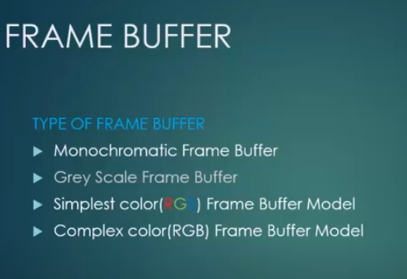

Slide 15
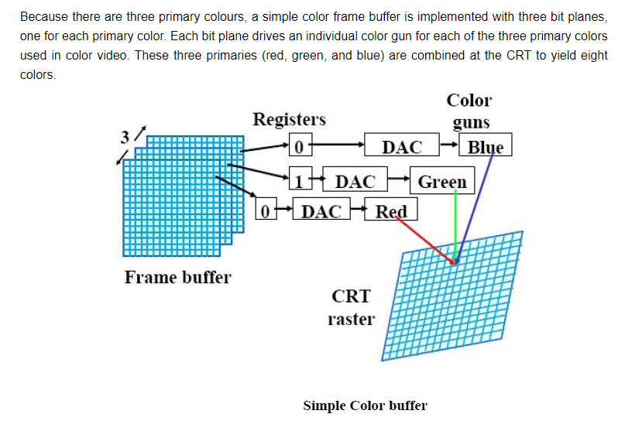
Working of frame buffer

Slide 16
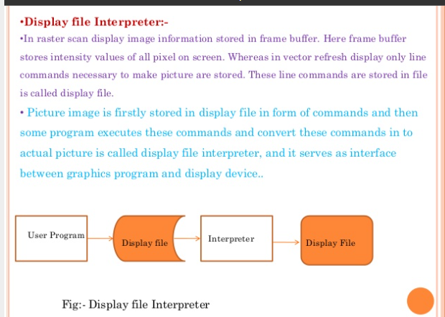

Slide 17
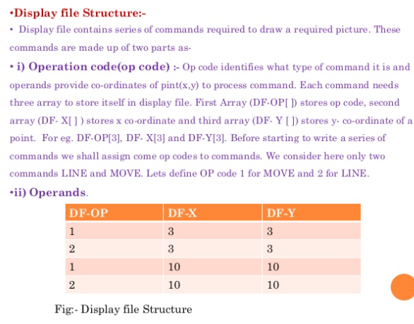

Slide 18
Ref Video Link
https://youtu.be/SQqT5lxYvcM

